Slide 1

OKR04 Permit Overview and Phase II Permittees
Part 2 of Stormwater 101 Training
Prepared by INCOG for
Green Country Stormwater Alliance (GCSA)
June 2020

Slide 2
Phase I and Phase II Permittees
Phase I EPA Rules (November 1990)
  Cities ≥ 100,000 population
  Industrial Activities (11 categories by SIC code)
Phase I in Oklahoma:
  Tulsa and Oklahoma City
  WWTPs ≥ 1 MGD
  Airports (w/ certain SIC codes)
  Landfills (receiving certain wastes)
  Construction sites (≥ 5 acres of disturbance)
Phase II EPA Rules (December 1999)
  Designated for having Urbanized Area
  Designated by State (pollution potential)
  Construction sites (≥ 1 acre of disturbance)

Slide 3

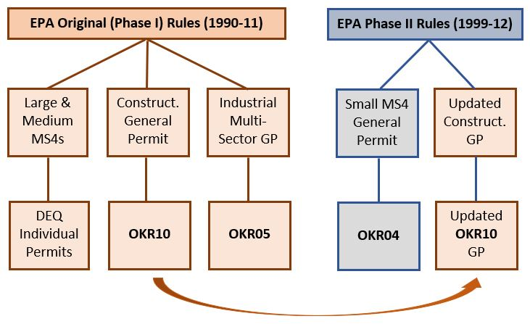
EPA Phase I and Phase II Rules and General Permits

Slide 4
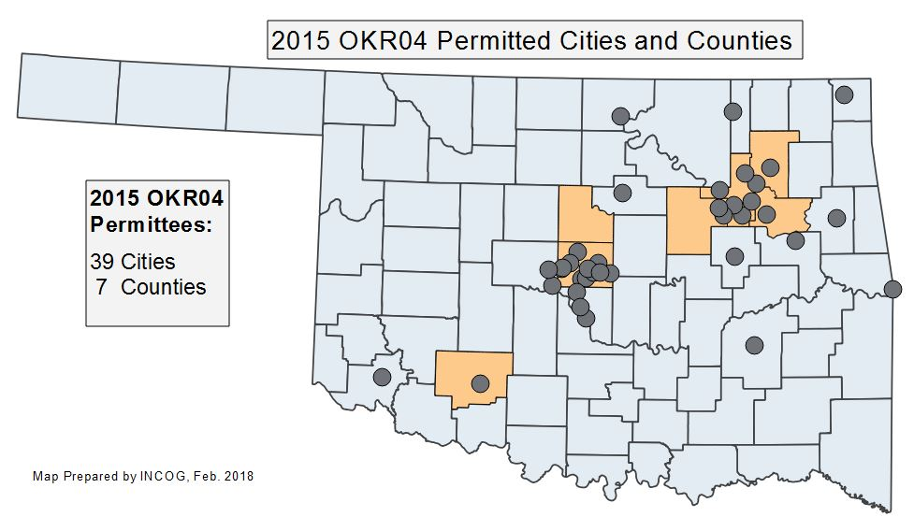
Text
39 cities
7 counties
ODOT
OTA
OU
Tinker AFB
Fort Sill AB

Slide 5
Proposed 2020 Phase II Permittees
1 | Altus | 15 | Fort Sill Army Base | 29 | Muskogee | 43 | Spencer
2 | Arkoma | 16 | Glenpool | 30 | Nichols Hills | 44 | Stillwater
3 | Bartlesville | 17 | Guymon * | 31 | Nicoma Park | 45 | Tahlequah
4 | Bethany | 18 | Harrah | 32 | Noble | 46 | Tinker Air Force Base
5 | Bixby | 19 | Jenks | 33 | Norman | 47 | The Village
6 | Broken Arrow | 20 | Jones | 34 | Oklahoma County | 48 | Tulsa County
7 | Catoosa | 21 | Logan County | 35 | Okla. Dept. Transp. ** | 49 | University of Oklahoma
8 | Choctaw | 22 | Kiefer | 36 | Oklahoma Turnpike Auth. | 50 | Wagoner County
9 | Claremore | 23 | Lawton | 37 | Okmulgee | 51 | Warr Acres
10 | Comanche County | 24 | McAlester | 38 | Owasso | 52 | Weatherford *
11 | Coweta | 25 | Miami | 39 | Ponca City | 53 | Yukon
12 | Creek County | 26 | Midwest City | 40 | Rogers County
13 | Del City | 27 | Mustang | 41 | Sand Springs
14 | Edmond | 28 | Moore | 42 | Sapulpa
* Designated new permittees in 2020 OKR04 Permit cycle.
** ODOT has an Individual Permit; no OKR04 permit.
41 | Cities and Towns |  |  | ## | GCSA Member
7 | Counties
5 | Non-municipals

Slide 6
What Is A “General Permit”?
“One size fits all” approach
MS4s apply for coverage
Agree to comply with GP
Individual Permit alternative
GP’s have simpler requirements
GP’s have 5-year life span
Continues after “expiration”
All MS4s have similar GP programs
Helps regional approaches

Slide 7
OKR04 Permit In A Nutshell
Water quality protection
Not a flood control permit
Public outreach & involvement
Stormwater pollution control
Construction site pollution
Low Impact Development (LID)
Municipal operations
Requires 3 local ordinances
Stormwater Management Plan (SWMP)
Annual Reports to DEQ
Protection of “Sensitive Waters”

Slide 8

Definition of “MS4”
40 CFR 122.26(b)(8) defines “Municipal Separate Storm Sewer System” (MS4) as:
“a conveyance or system of conveyances (including roads with drainage systems, municipal streets, catch basins, curbs, gutters, ditches, man-made channels, or storm drains) … owned or operated by a State, city, town, borough, county, parish, district, association, or other public body …”

Slide 9
Illicit Discharge Definition
FROM EPA REGULATIONS:
Part 122.26(b)(2) “Illicit discharge means any discharge to a municipal separate storm sewer that is not composed entirely of storm water except discharges pursuant to a NPDES permit…
(other than the NPDES permit for discharges from the municipal separate storm sewer) and discharges resulting from fire fighting activities.”

Slide 10
Oklahoma “Waters of the State”
Means: “all streams, lakes, ponds, marshes, watercourses, waterways, wells, springs, irrigation systems, drainage systems, and all other bodies or accumulations of water, surface and underground, natural or artificial, public or private, which are contained within, flow through, or border upon this State or any portion thereof”
DEQ stormwater permits have adopted this definition..
National stormwater permits use “Waters of the US”.

Slide 11
Minimum Control Measures (MCMs)
From EPA Rules and OKR04 Permit:
Public education & outreach
Public participation & involvement
Illicit Discharge detection & elimination
Construction site runoff control
Post-construction for developments
Good housekeeping for MS4 operations
“Best Management Practices” (BMPs)

Slide 12
Three Local Ordinances Are Required
Illicit Discharge Ordinance:
Local enforcement to control pollution.
Covers all sources not exempted.
Construction Ordinance:
Local enforcement of active construction sites.
Must work with State OKR10 permit.
Post-Construction Ordinance:
Long-term pollution control of project itself.
Low Impact Develop (LID) based.
Ordinances can be combined.
Can use “other regulatory mechanism”.

Slide 13
SWMP Document
Stormwater Management Program (SWMP).
Describes how local MS4 will comply.
Strategies and Responsible Parties.
Methods & procedures for compliance.
BMPs’ “Measurable Goals” & schedules.
Assessing BMP and program effectiveness.
MS4 management structure & resources.

Slide 14

Annual Reports to DEQ
Main way for DEQ to verify compliance.
Can use Annual Report Templates.
Status of BMP implementation.
Assess BMP and program effectiveness.
Activities and BMPs planned for next cycle.
Changes planned for next cycle.
TMDL monitoring & compliance report.

Slide 15
Special Conditions: Sensitive Waters
303(d):
Impaired Beneficial Uses
Additional OKR04 requirements
TMDLs:
Stormwater MS4s must comply
OKR04 & TMDL Report requirements
2020 OKR04 lists MS4s with TMDLs
ARC:
“Aquatic Resources of Concern”
Protected species & critical habitat
ORW:
“Outstanding Resource Waters”
Special requirements; Tahlequah only

Slide 16
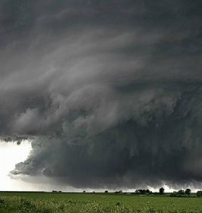
This ends Part 2…
Thanks !

